Slide 1
ML Model Deployment -- Using AWS Cloud Infrastructure
Shanker Valipireddy

Slide 2
Executive Summary
Objective and Scope
The proposed work plan aims to create IRIS model using Python script (train.py)and create a Docker image and deploy in AWS ECS container. Also create endpoint using AWS API Gateway which users can use for predictions. Lambda function acts as integration point between ECS and API gateway for predictions.
The project will be divided into several stages, Create Model, Create Docker imange, Create Lambda function, Create ECS Cluster and deploy model and Create API Gateway endpoint using lambda function.
A detailed steps at each stage is provided. Architecture diagram provided for IRIS ML Model Deployment
Key Deliverables :
The key deliverables of the project include IRIS model , Python code, Lambda function, endpoint
Potential Outcomes:
The potential outcomes of the project include the endpoint which is available for users

Slide 3
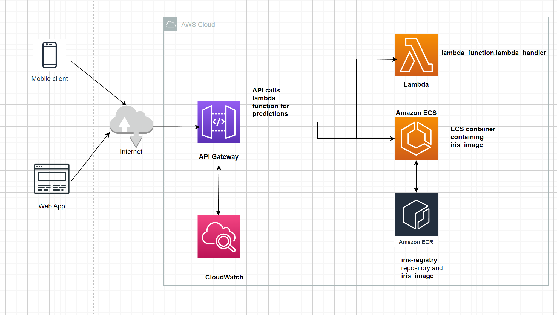
Project Architecture
Model Deployment workflow
API call created by APY gateway invokes lambda function within container image.
ECR iris-registry contains the Docker image and Lamda function is within lambda. Docker image with dependencies deployed in ECS.
Either mobile or Web Application users can access the endpoint
Logs are available in CloudWatch

Slide 4
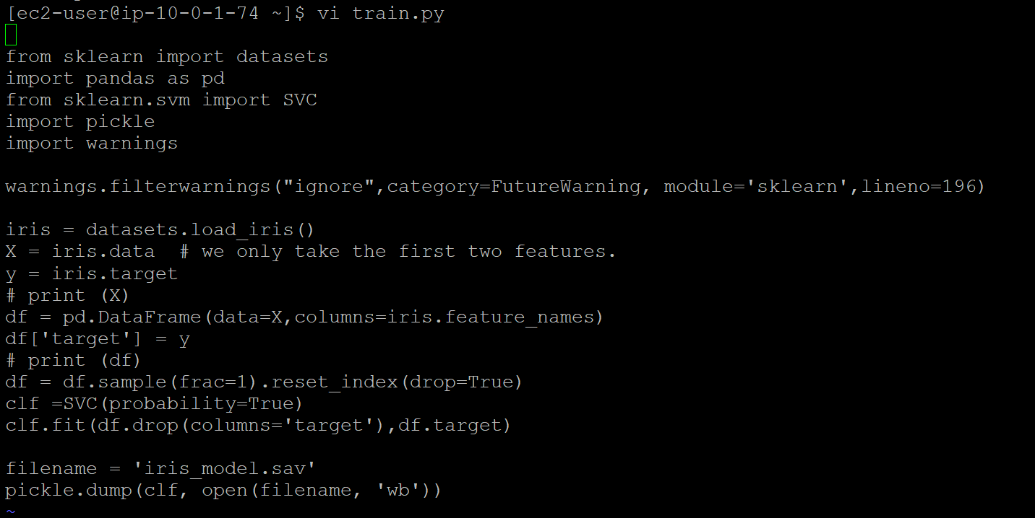
Work Plan- Steps
Below are the steps performed to create iris-model and deployed in ECS container and created endpoint using API Gateway.
Train your model using a framework and save the trained model's weights to a file. Below is the train.py function that performs the training task and saves model file:

Slide 5
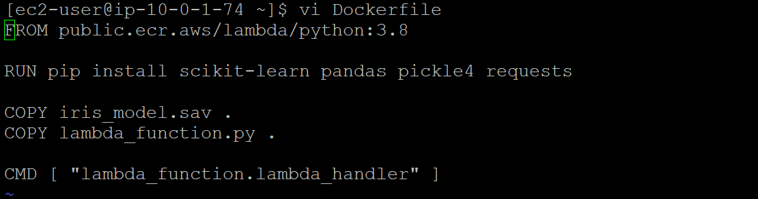
Work Plan- Steps
Below are the steps performed to create iris-model and deployed in ECS container and created endpoint using API Gateway.
2. Create a container image using Docker that includes the necessary dependencies, such as the framework and any additional libraries needed to run the model. Below is the code:

Slide 6
Work Plan- Steps
3. Use AWS Elastic Container Registry (ECR) to store the above container image. Below are the commands.
aws ecr create-repository --repository-name iris-registry --region us-west-1
# Log in to ECR
aws ecr get-login-password --region us-west-1 | docker login --username AWS --password-stdin 149509065833.dkr.ecr.us-west-1.amazonaws.com
docker build -t iris-registry .
# Tag the image
docker tag iris_image:latest 149509065833.dkr.ecr.us-west-1.amazonaws.com/iris_image
# Push the image to ECR
docker tag iris-registry:latest 149509065833.dkr.ecr.us-west-1.amazonaws.com/iris-registry:latest

Slide 7
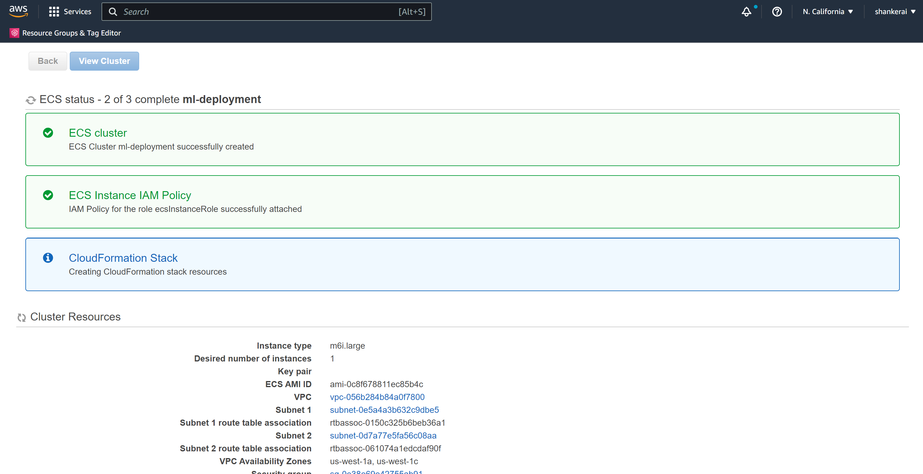
Work Plan- Steps
4. Create an ECS Cluster. Below is the screenshot.
.

Slide 8
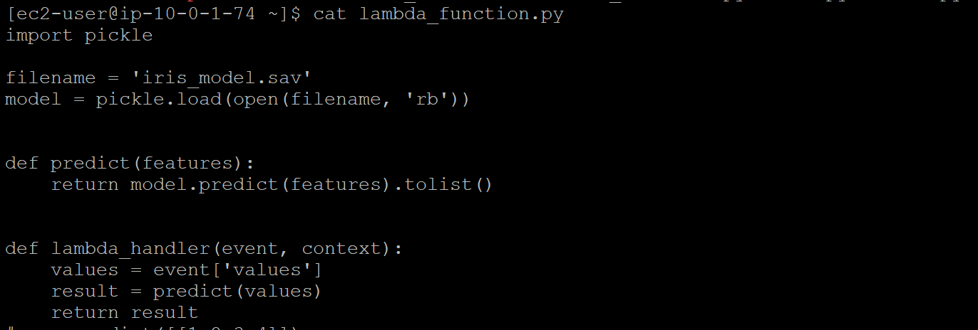
Work Plan- Steps
5. Create a Lambda function that calls the API endpoint and processes the input and output of the model.

Slide 9
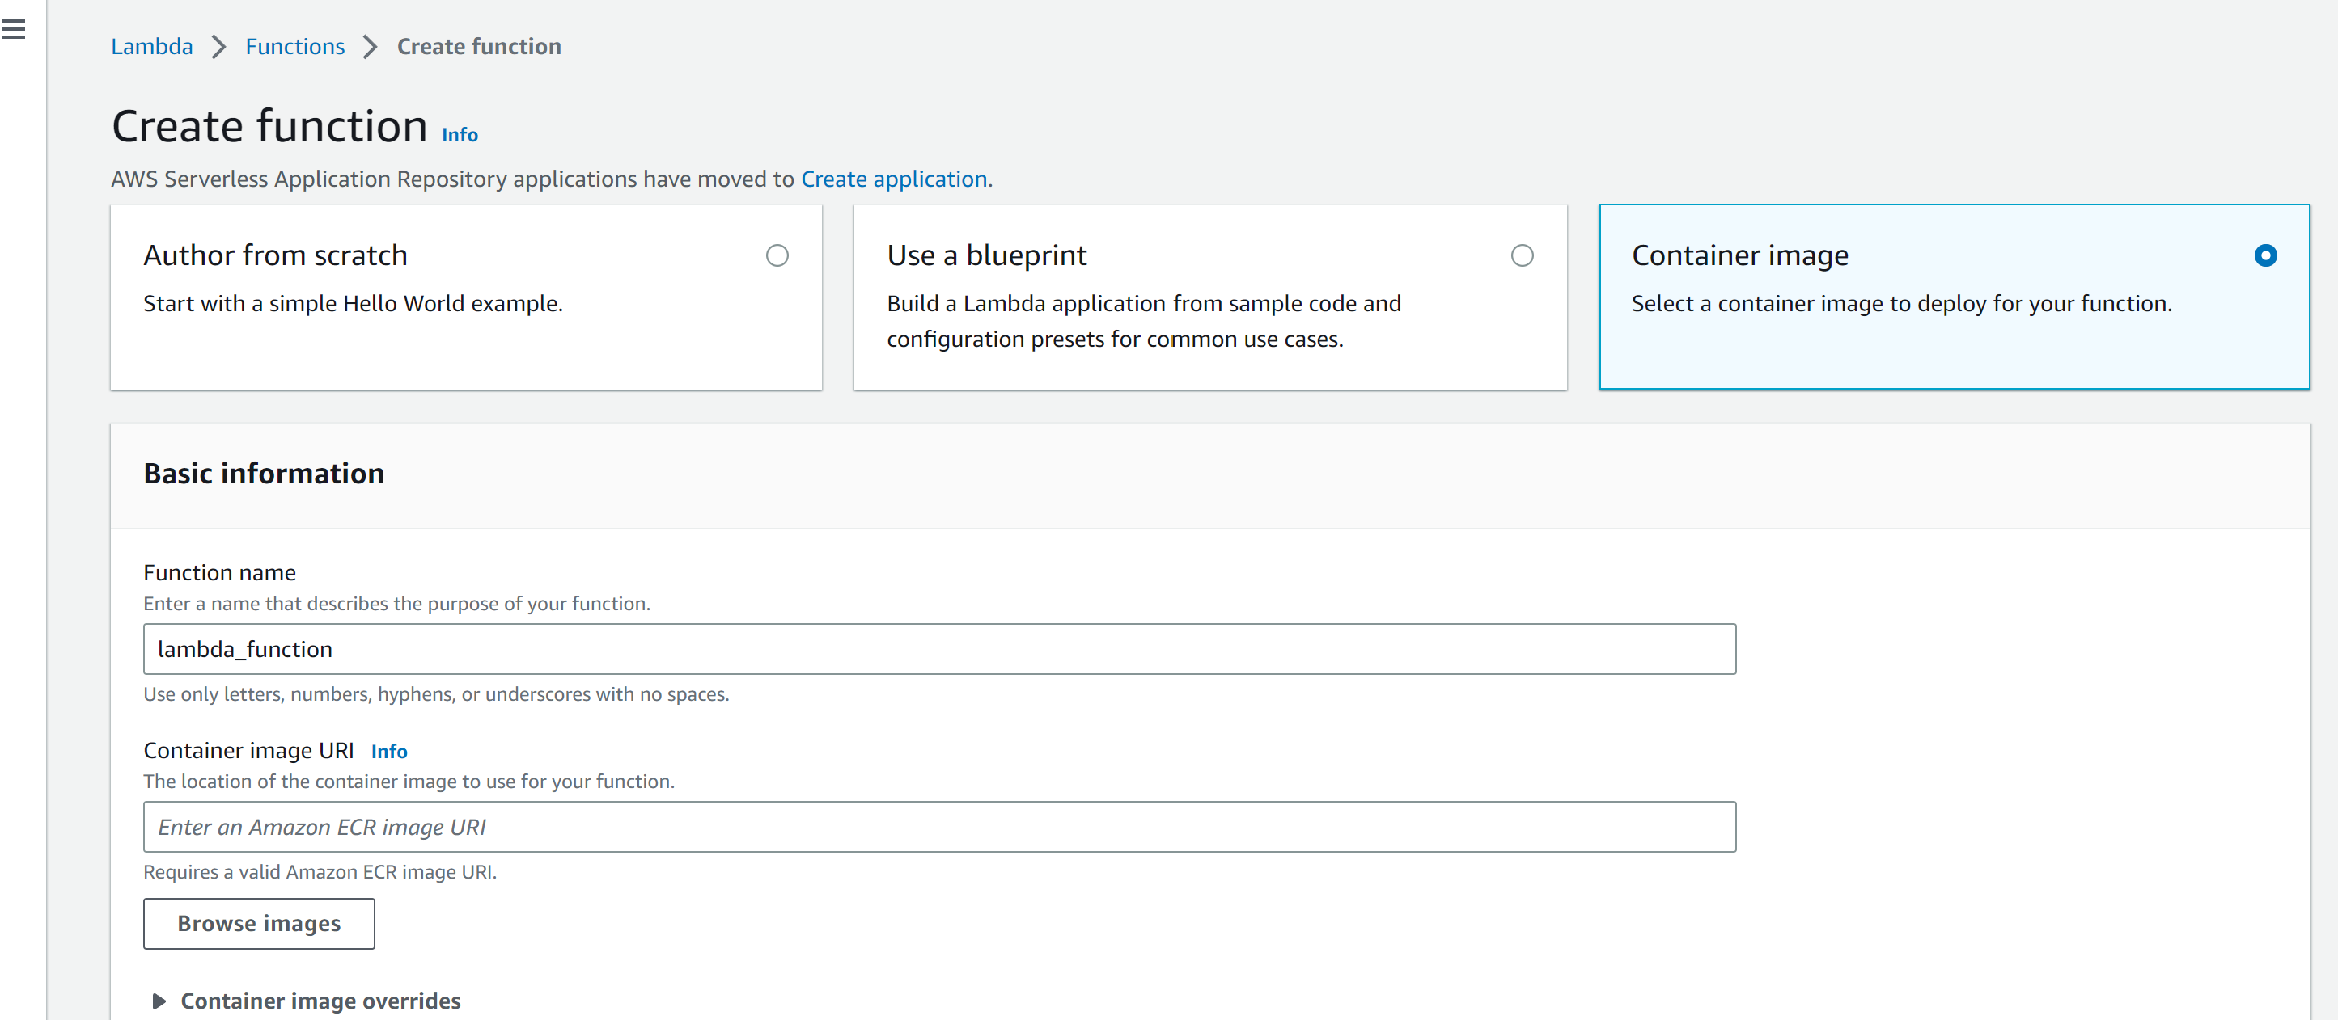
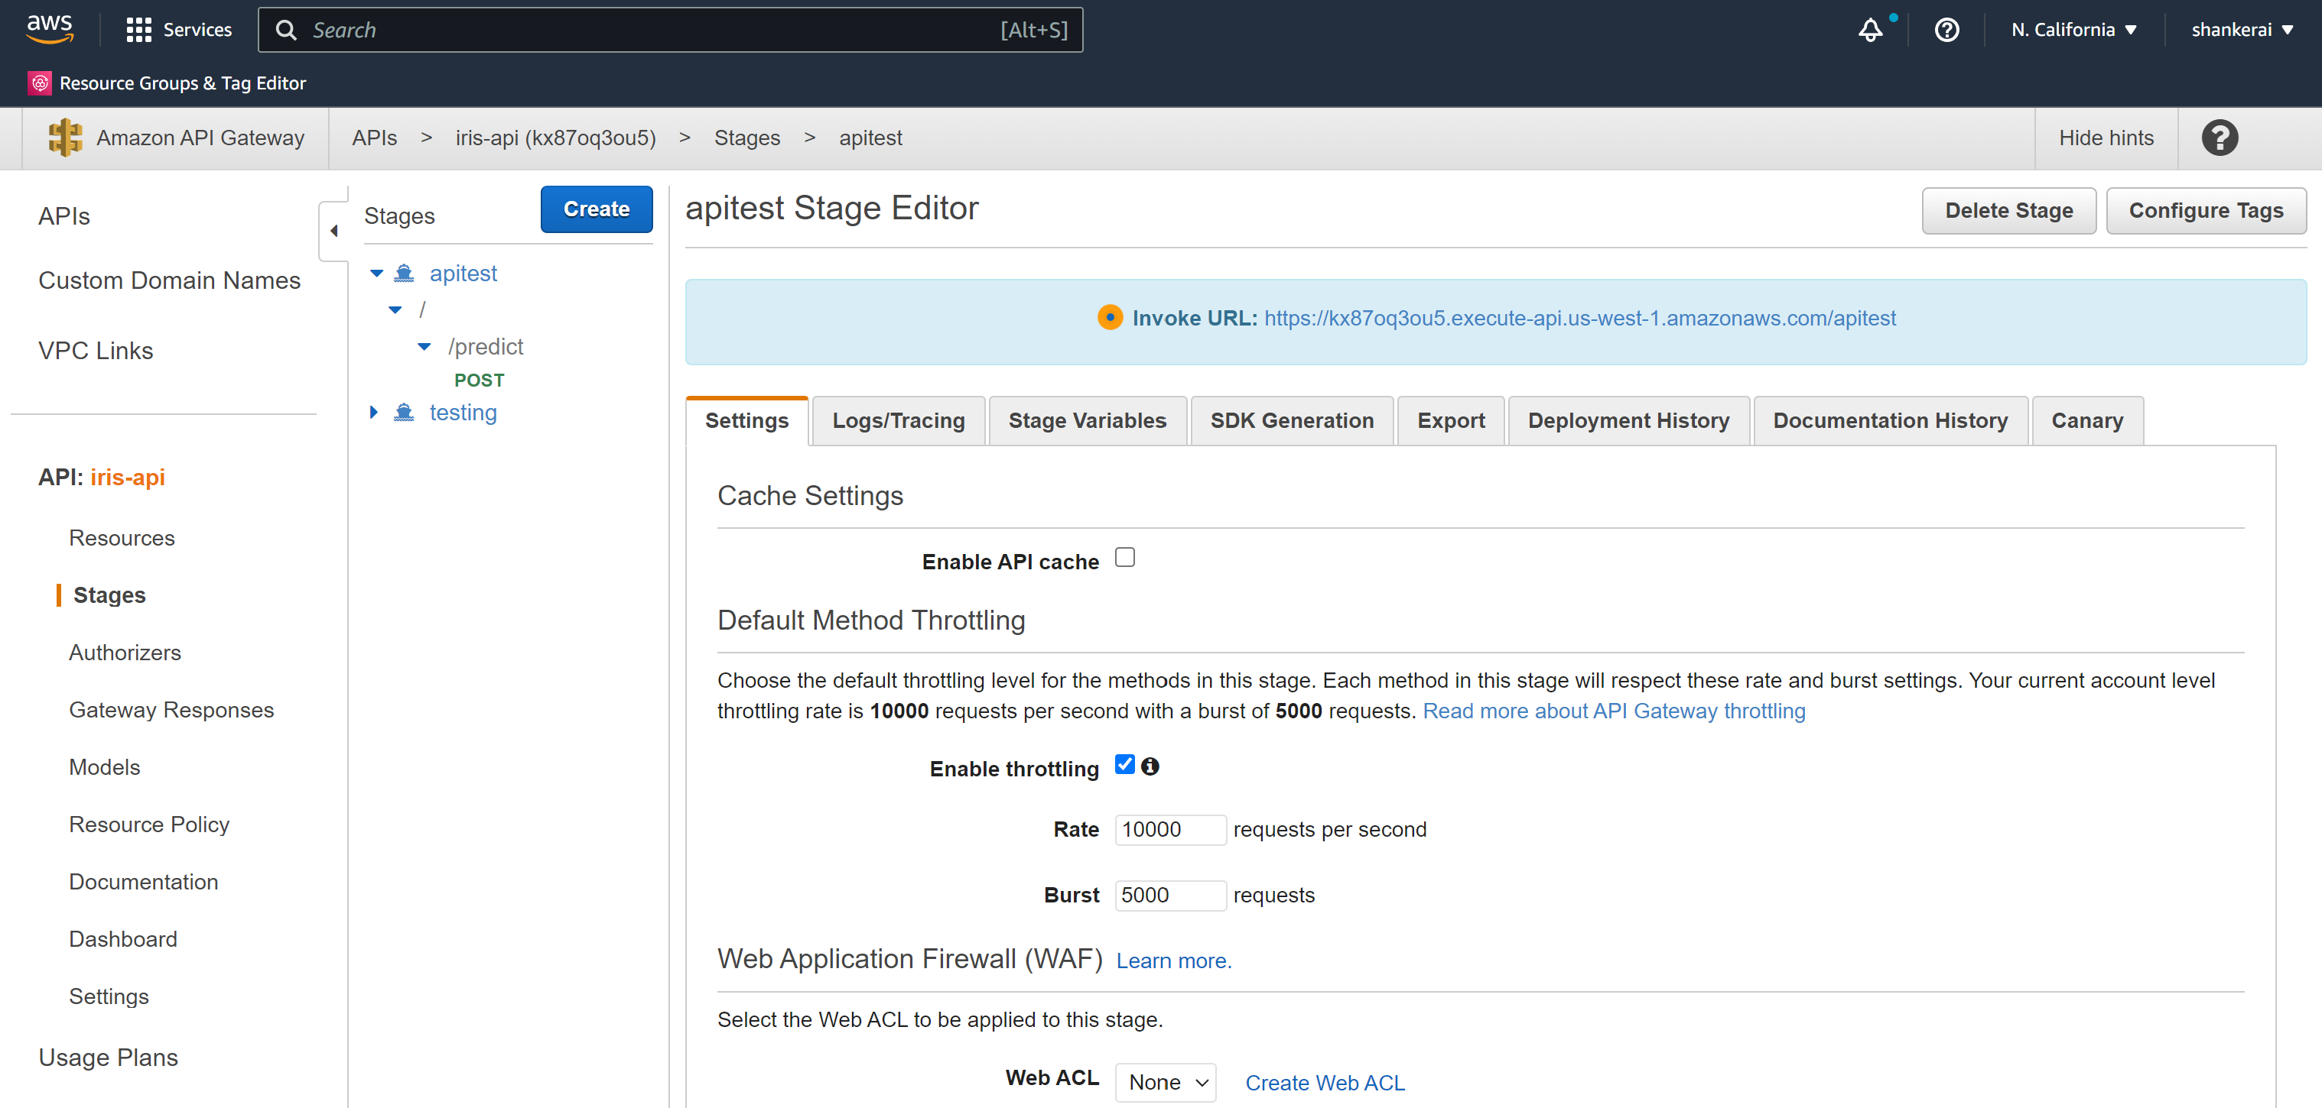
6. Create an API Gateway that triggers the Lambda function, and expose the API Gateway's endpoint as the API for the model. I have performed these tasks using Amazon Management Console but we can also use Cloudformation template to automate the whole process. I have created template but not tested.

Slide 10
7. Testing the endpoint:
Rest API POST call for endpoint:
https://kx87oq3ou5.execute-api.us-west-1.amazonaws.com/apitest/predict
Input:
{"values": [[5, 2, 4, 4]]}
Output:
[2]

Slide 11
Thanks

